Slide 1


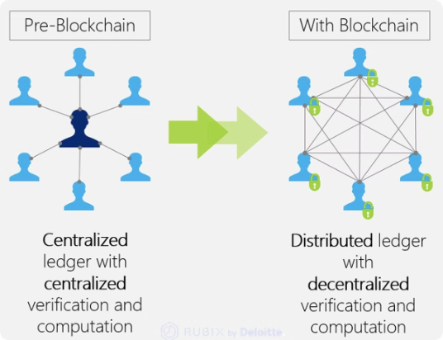
Decentralized Dispute Resolution with GRULL Tokens
This innovative system leverages the power of blockchain technology and GRULL tokens to create a secure and transparent platform for decentralized dispute resolution. By utilizing GRULL tokens for juror selection and staking, the system ensures fair and impartial judgments while mitigating the risks of traditional dispute resolution methods. This approach fosters trust and accountability within the ecosystem, providing a more efficient and equitable process for all participants.
Notes:
1

Slide 2

Key Challenges in Decentralized Dispute Resolution
Efficient Juror Selection
Fairness
Sybil Attacks
Finding qualified and active jurors is crucial. Traditional jury selection processes are often time-consuming and costly. Decentralized systems must streamline this process while ensuring the selection of competent and impartial individuals.
Maintaining fairness is paramount. The system needs to prevent bias and ensure all parties have an equal opportunity to present their case. This requires careful consideration of juror selection, stake weighting, and dispute assignment mechanisms.
Sybil attacks, where a single entity creates multiple fake identities to manipulate the system, pose a significant threat. Robust identity verification and minimum staking requirements are essential to counter these attacks and maintain the integrity of the dispute resolution process.
Notes:
2

Slide 3

Proposed Solutions for a Robust System
1
Dynamic Token Pricing
2
Weighted Random Selection
A dynamic pricing model for GRULL tokens, where the price increases with demand, discourages excessive accumulation and promotes a more balanced distribution of tokens among participants.
Weighted random selection of jurors, proportional to their stake but with diminishing returns, ensures fair representation for both large and small stakeholders, preventing dominance by any single entity.
3
Randomized Juror Pools
4
Incentive Alignment
Assigning disputes to randomized juror pools mitigates the risk of manipulation and collusion, enhancing the overall security and impartiality of the dispute resolution process.
Aligning incentives through rewards for honest voting and penalties for dishonest behavior encourages jurors to act with integrity and make fair decisions based on the evidence presented.
Notes:
3

Slide 4

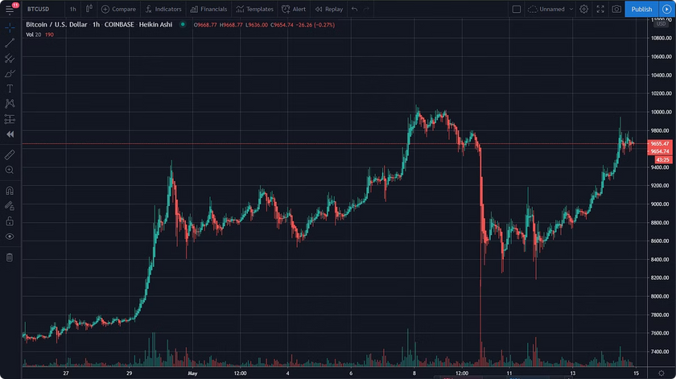
Dynamic GRULL Token Pricing
Demand-Based Pricing
Preventing Monopolization
The GRULL token price adjusts dynamically based on demand, creating a responsive market mechanism that reflects the token's utility within the dispute resolution ecosystem.
By increasing the cost of GRULL tokens as demand rises, the system discourages large-scale accumulation by any single entity, promoting a more distributed and democratic participation in the juror selection process. This prevents whales from dominating the system.
Market Stability
Dynamic pricing contributes to market stability by balancing supply and demand for GRULL tokens. This mechanism helps prevent extreme price fluctuations and ensures the sustainable operation of the dispute resolution platform.
Notes:
4

Slide 5
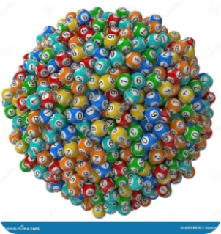
Weighted Random Juror Selection
Stake Proportionality
Diminishing Returns
Fair Representation
Juror selection chances increase proportionally with the amount of GRULL tokens staked, giving those with a greater vested interest a higher probability of being selected. This incentivizes active participation and commitment to the platform.
The system incorporates diminishing returns to prevent dominance by large stakeholders. While a higher stake increases selection chances, the marginal benefit decreases as the stake grows, ensuring fair representation for smaller token holders.
The combination of stake proportionality and diminishing returns ensures fair representation for all stakeholders, regardless of their stake size. This fosters a more inclusive and equitable dispute resolution environment.
Notes:
5

Slide 6

Randomized Juror Pools for Enhanced Security
1
Random Distribution
2
Attack Mitigation
Disputes are assigned to randomly selected juror pools, ensuring a diverse and unbiased set of jurors for each case. This process prevents predictable outcomes and enhances the fairness of the system.
Randomized juror pools mitigate the risk of targeted attacks and collusion by making it difficult for malicious actors to predict which jurors will be assigned to a specific dispute. This enhances the system's security and resilience against manipulation.
3
Decentralization
The randomized nature of juror pool selection reinforces the decentralized nature of the platform, reducing the potential for single points of failure or control. This strengthens the overall integrity and trustworthiness of the dispute resolution process.
Notes:
6

Slide 7
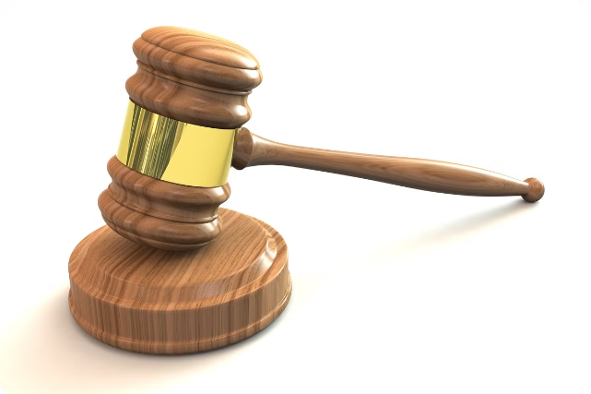
Incentivizing Honest Voting in Dispute Resolution
Honest Voting
Dishonest Voting
Jurors who vote honestly are rewarded with arbitration fees and a share of penalties collected from dishonest jurors. This incentivizes ethical behavior and reinforces the importance of impartial judgment.
Dishonest jurors face penalties, including the forfeiture of a portion of their staked tokens, which are then redistributed to honest jurors. This mechanism discourages malicious behavior and promotes accountability within the system.
Notes:
7

Slide 8
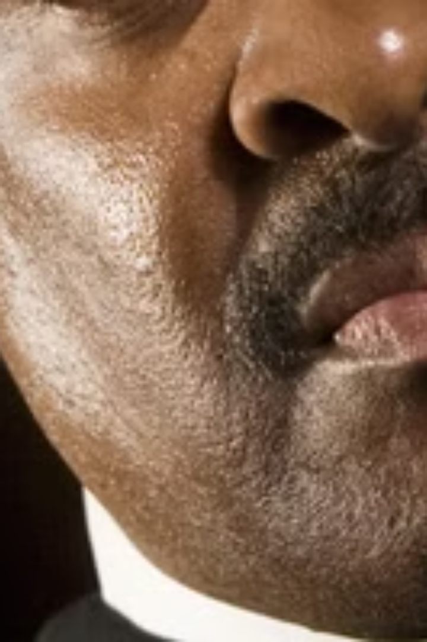



Penalty Mechanism for Dishonest Voting
Vote Discrepancy
The system detects discrepancies between a juror's vote and the majority decision. This triggers the penalty mechanism, ensuring accountability for potentially biased or malicious voting behavior.
Penalty Imposed
A penalty, proportional to the staked tokens, is imposed on the juror whose vote deviates significantly from the majority. The severity of the penalty reflects the degree of discrepancy and discourages future dishonest behavior.
Redistribution
The forfeited tokens from dishonest jurors are redistributed to the honest jurors in the pool, further incentivizing ethical participation and compensating those who contributed to a fair and accurate outcome.
Notes:
8

Slide 9
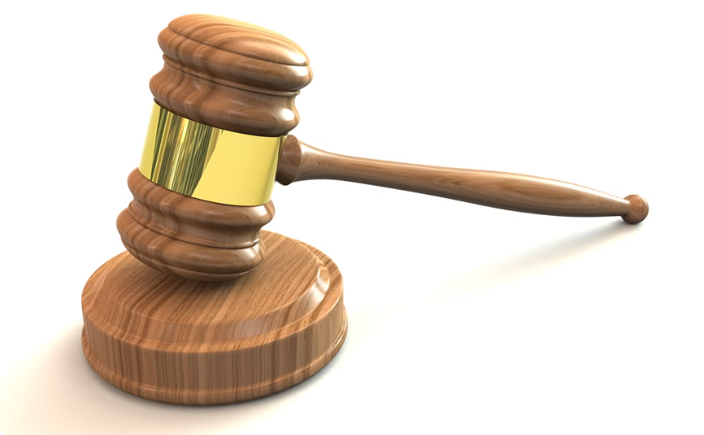

Reward System for Majority Jurors
Arbitration Fees
Penalty Shares
Jurors who participate in dispute resolution and contribute to the majority decision earn arbitration fees. These fees compensate jurors for their time and expertise in evaluating the evidence and reaching a fair verdict.
In addition to arbitration fees, honest jurors receive a share of the penalties collected from dishonest jurors. This further incentivizes honest participation and reinforces the system's commitment to fair and ethical conduct.
Notes:
9

Slide 10
Conclusion
The GRULL token-based decentralized dispute resolution system offers a novel approach to resolving disputes fairly and securely. By addressing key challenges like juror selection, fairness, and Sybil attacks through innovative solutions such as dynamic token pricing, weighted random selection, randomized juror pools, and robust incentive mechanisms, this system fosters trust, transparency, and accountability within the decentralized ecosystem. This groundbreaking approach promises to revolutionize dispute resolution, providing a more efficient, equitable, and secure platform for all participants.
1
Transparency
2
Efficiency
3
Security
All transactions and voting records are immutably stored on the blockchain, ensuring complete transparency and auditability.
Automated processes and smart contracts streamline dispute resolution, significantly reducing time and costs compared to traditional methods.
Decentralization and cryptographic security measures protect the system from manipulation and fraud, ensuring the integrity of the process.
Notes:
10

